Slide 1

RUNGTA COLLEGE OF DENTAL SCIENCES & RESEARCH
RECENT ADVANCES IN CARIES DIAGNOSIS
DEPARTMENT OF PEDODONTICS AND PREVENTIVE DENTISTRY

Slide 2
SPECIFIC LEARNING OBJECTIVES
Core areas | Domain
Introduction Definition Objectives Requisites | Various diagnostic aids. Miscellaneous

Slide 3
CATEGORY
MUST TO KNOW
NICE TO KNOW
Endoscopy
DESIRE TO KNOW
Electrical conductance measurements
Illumination methods
Radiography
Lasers
Miscellaneous

Slide 4
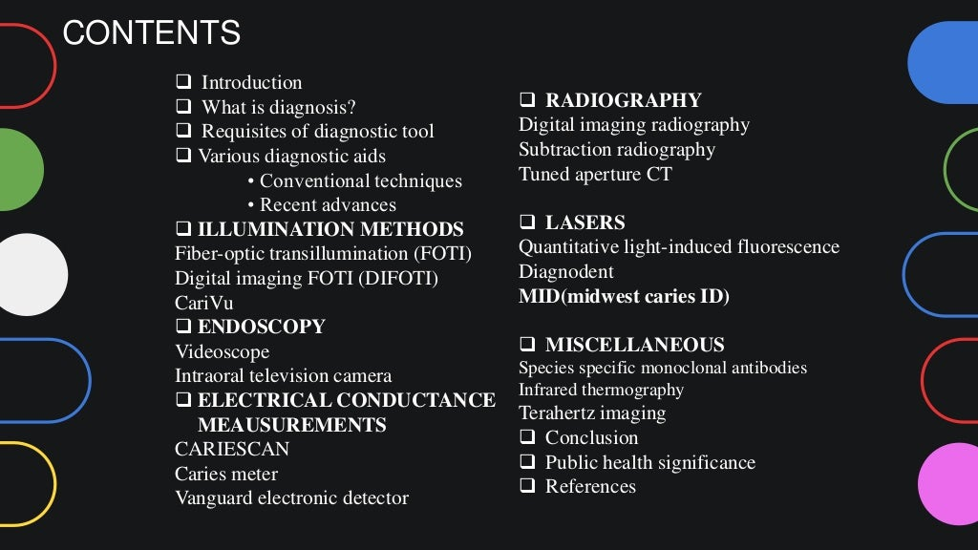

Slide 5
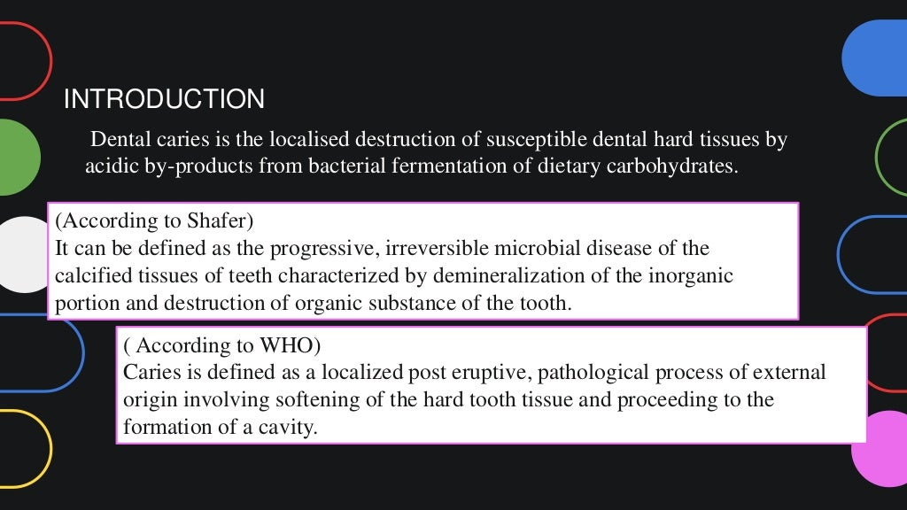

Slide 6
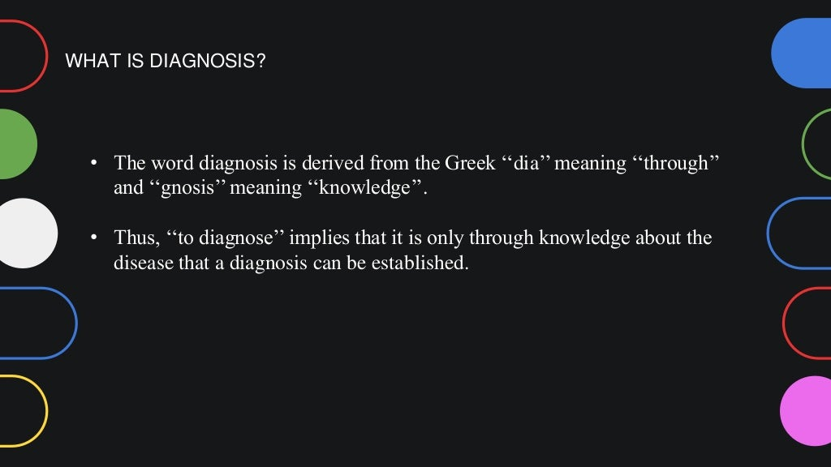

Slide 7
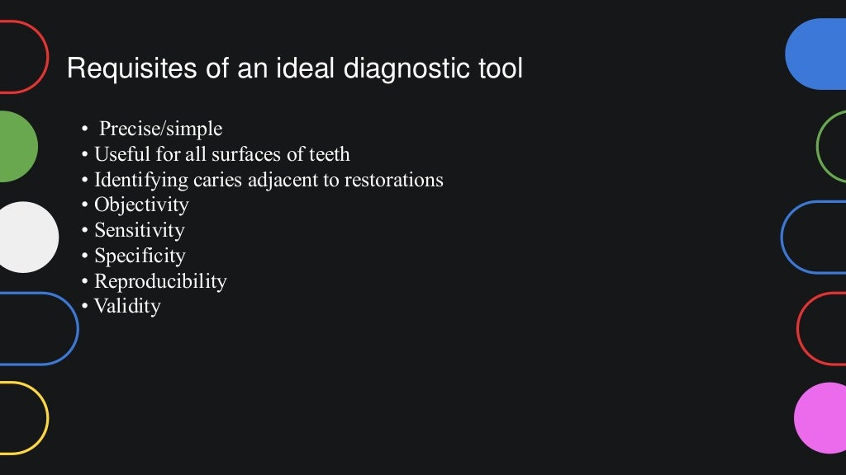

Slide 8
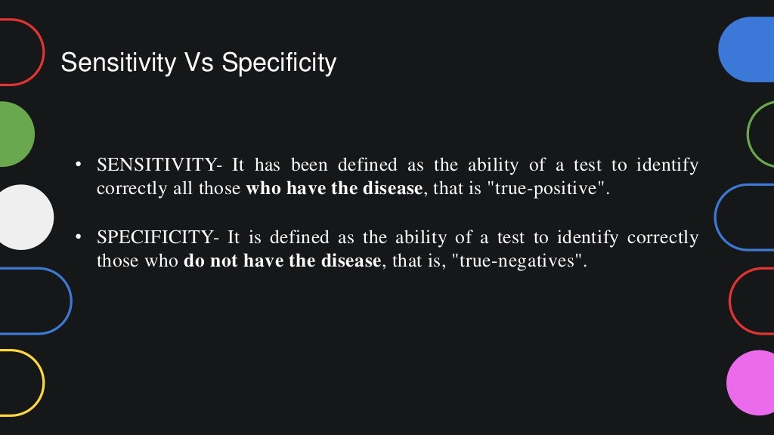

Slide 9
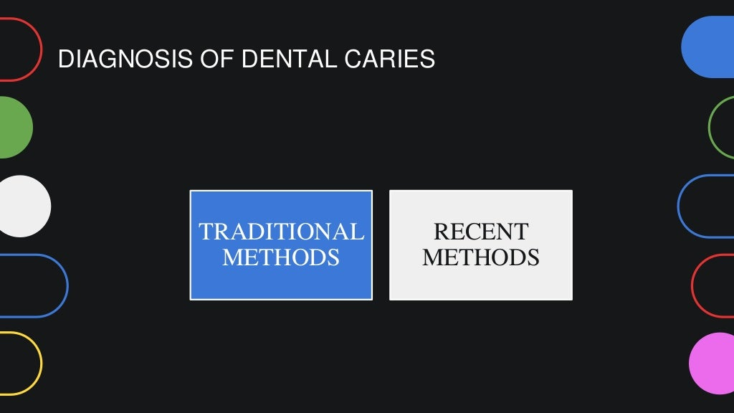

Slide 10
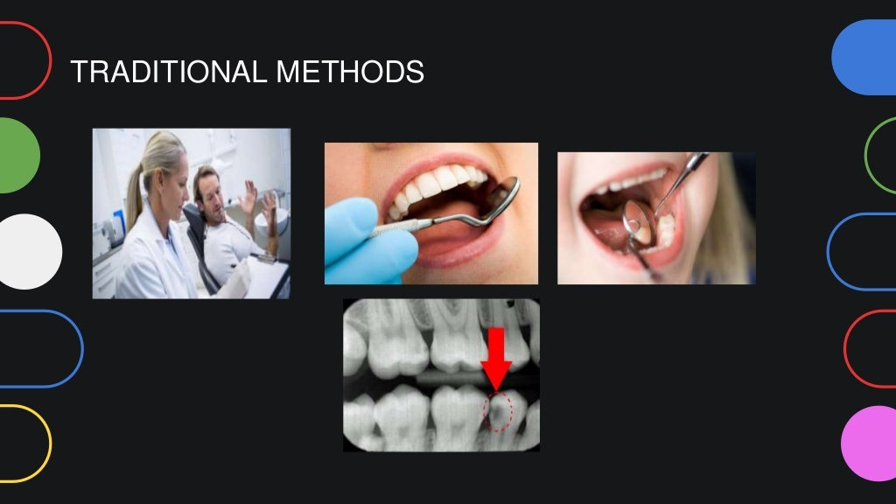

Slide 11
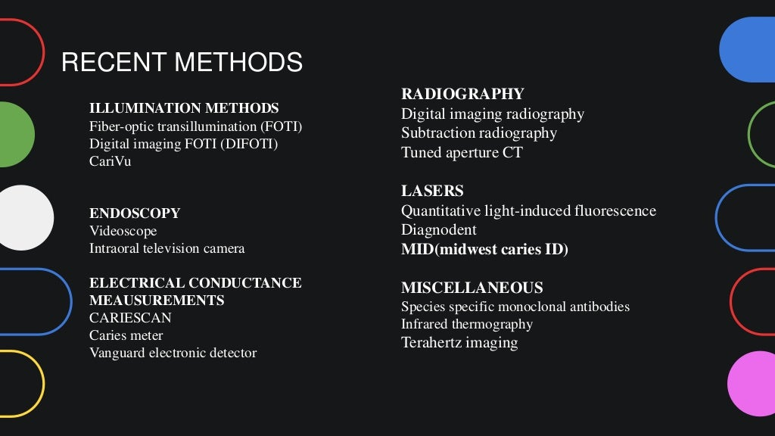

Slide 12
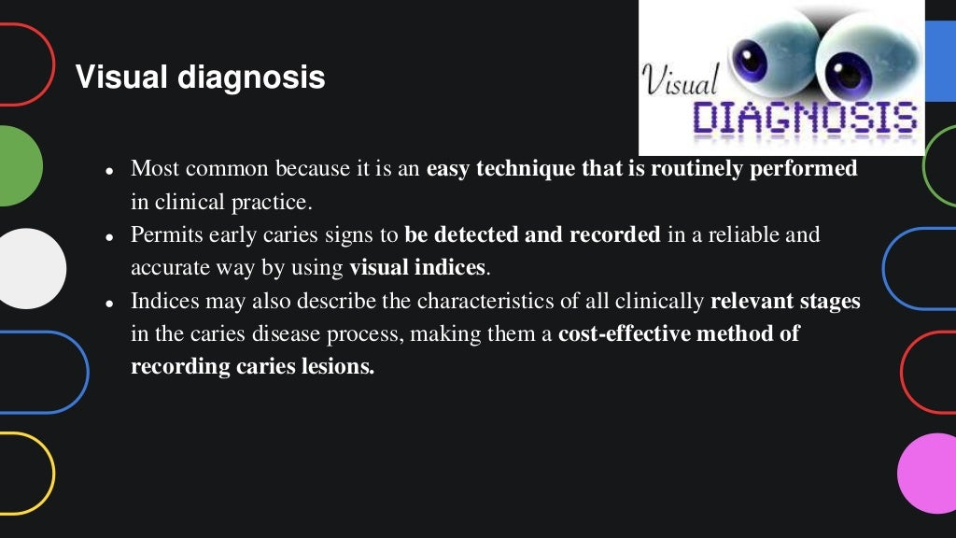

Slide 13
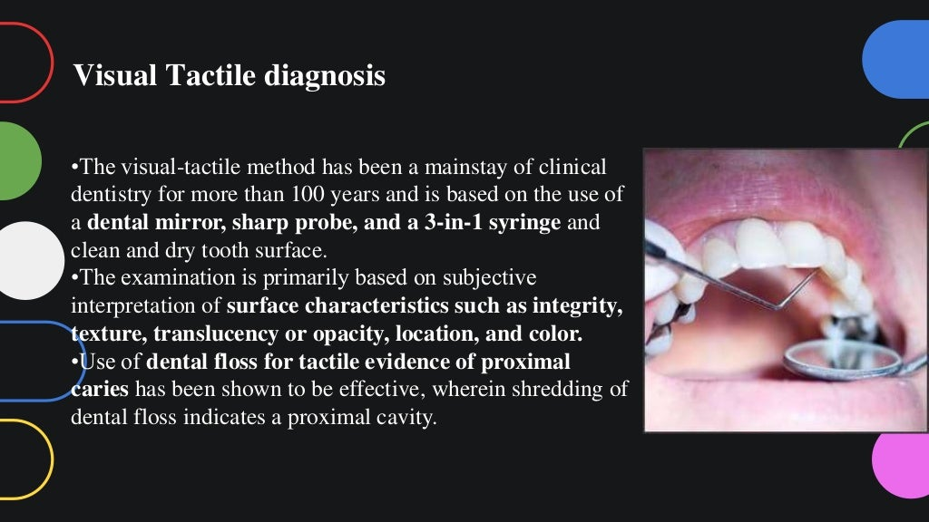

Slide 14
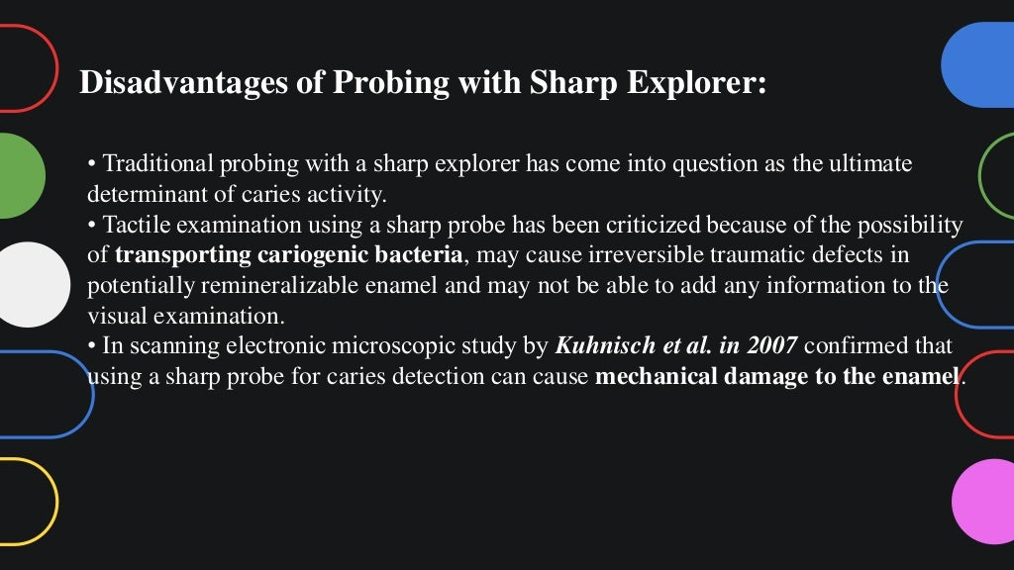

Slide 15
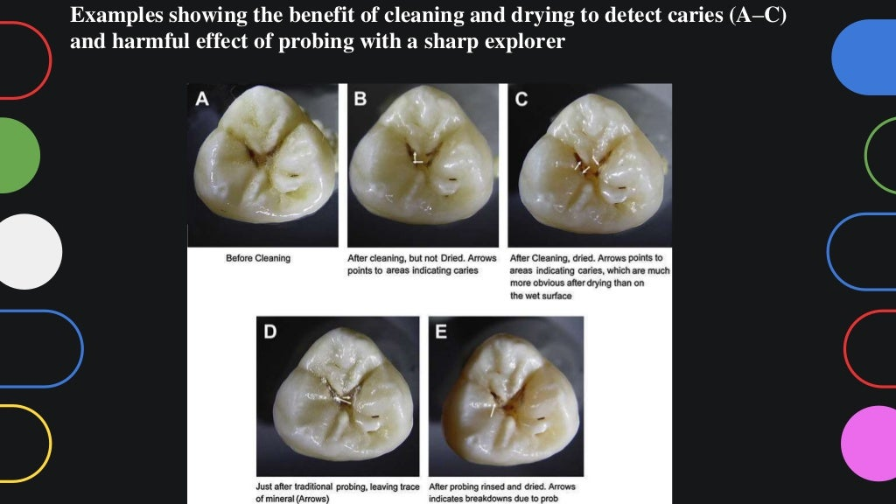

Slide 16
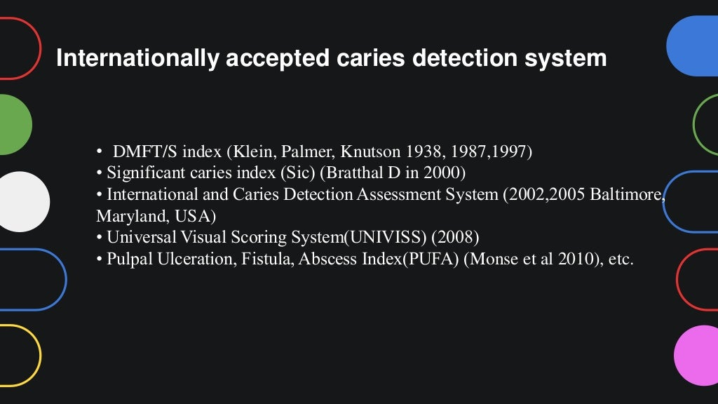

Slide 17
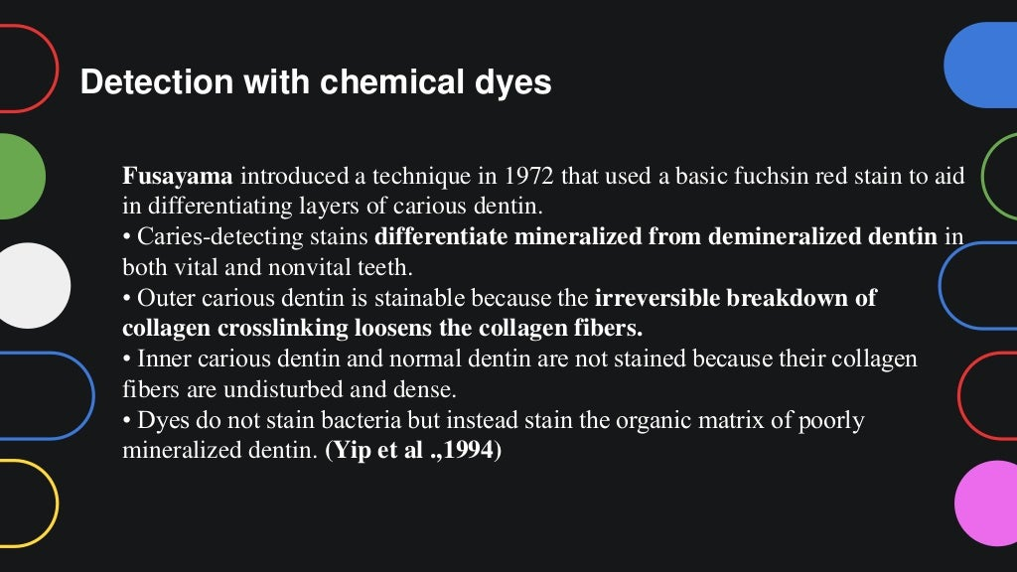

Slide 18
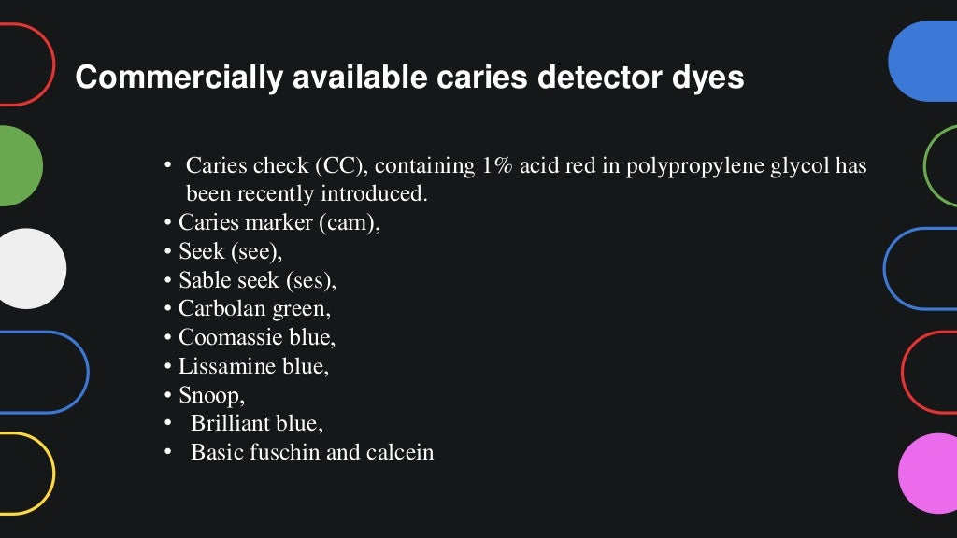

Slide 19
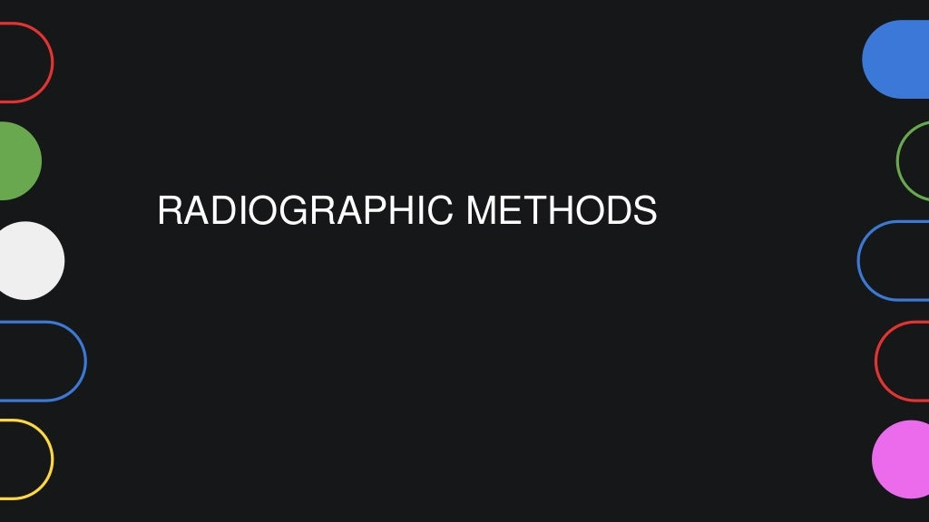

Slide 20
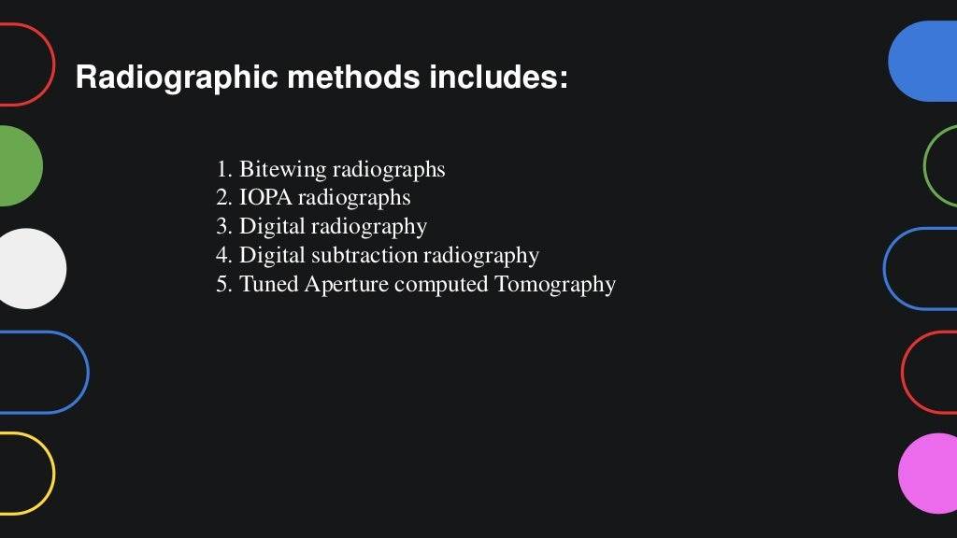

Slide 21
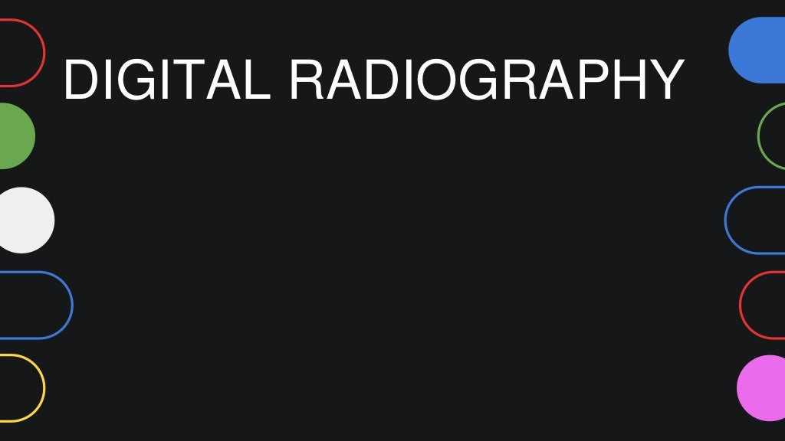

Slide 22
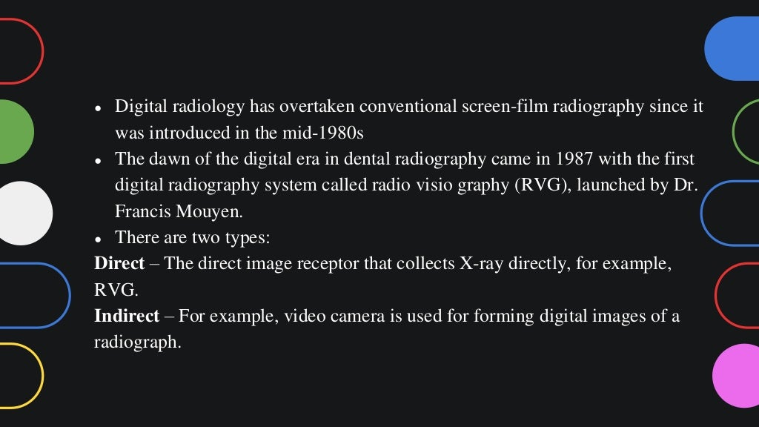

Slide 23
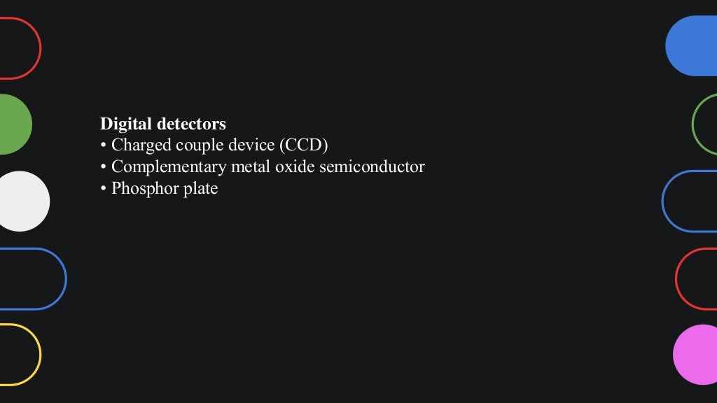

Slide 24
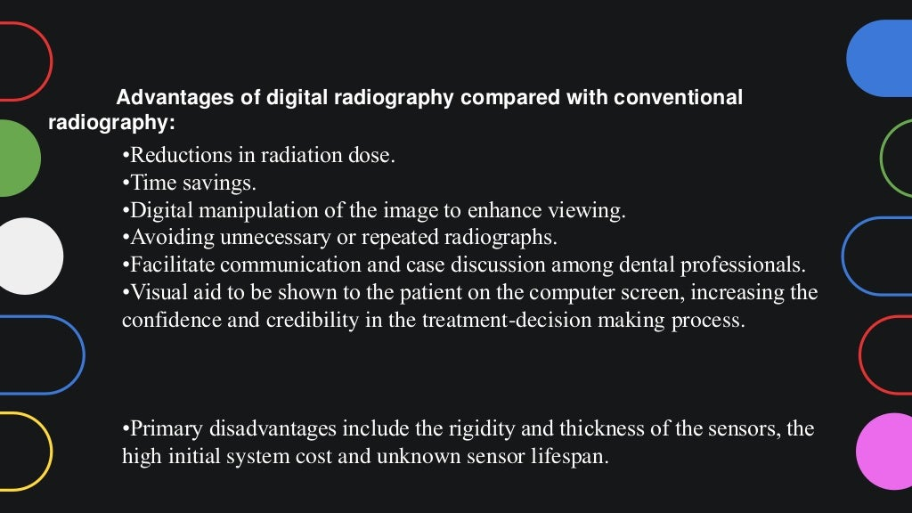

Slide 25
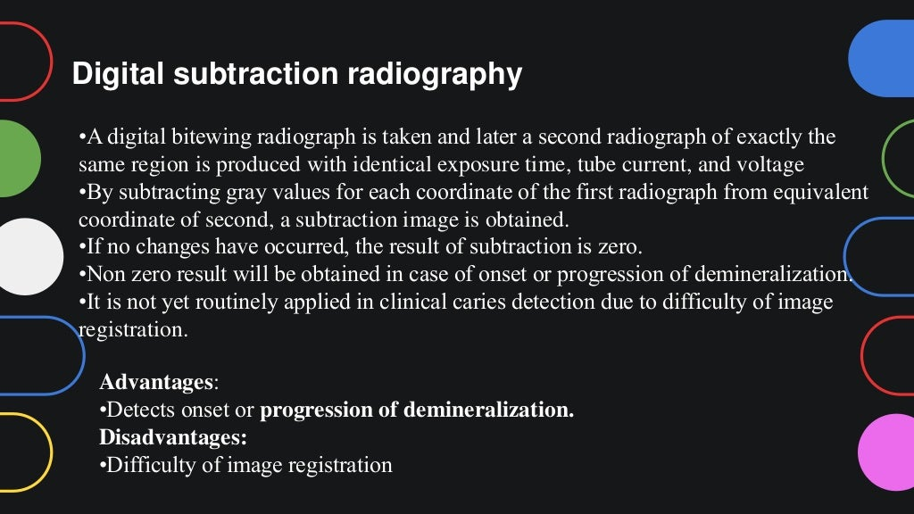

Slide 26
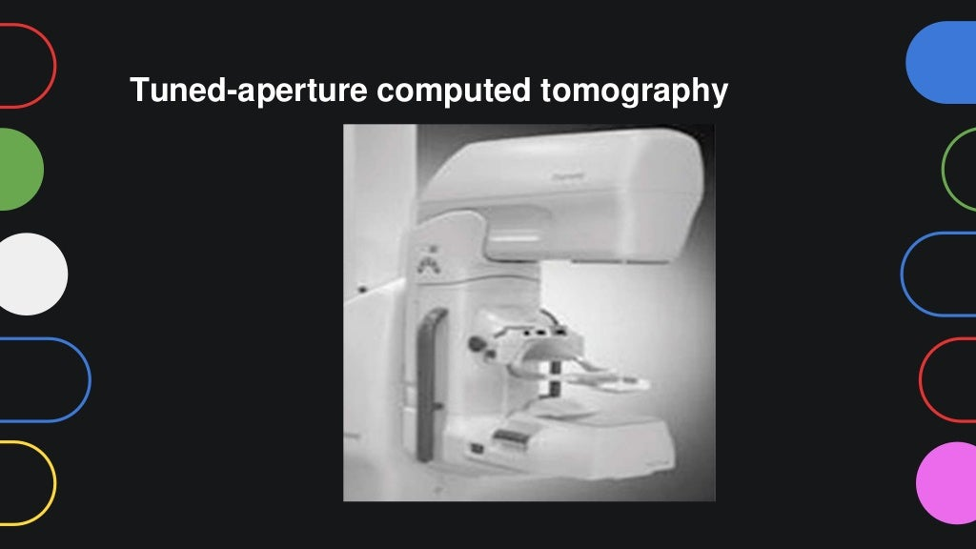

Slide 27
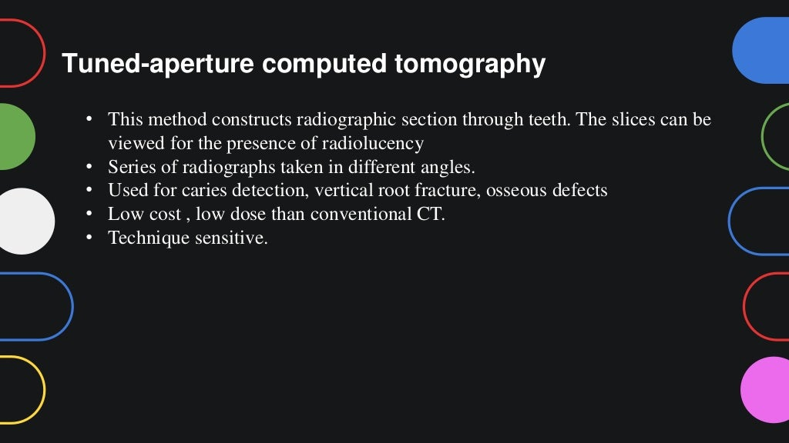

Slide 28
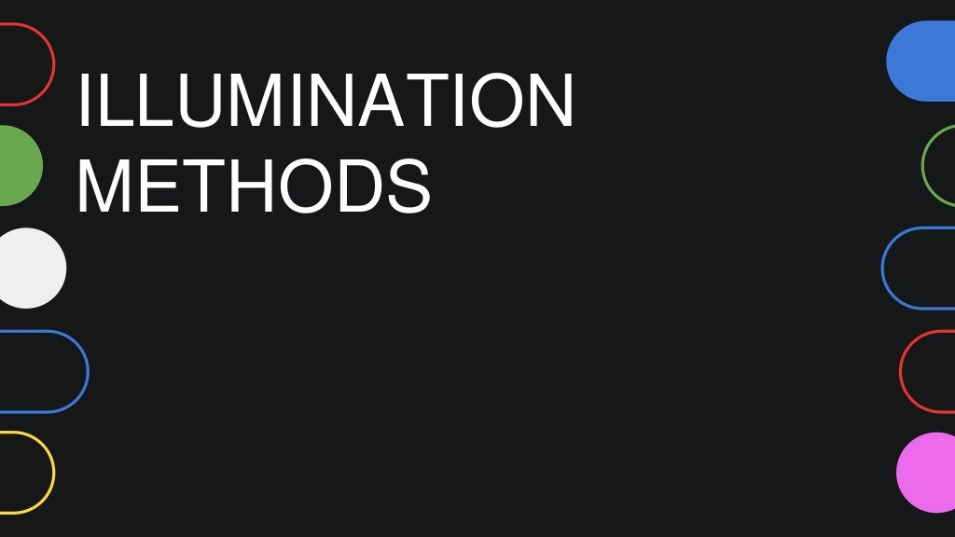

Slide 29
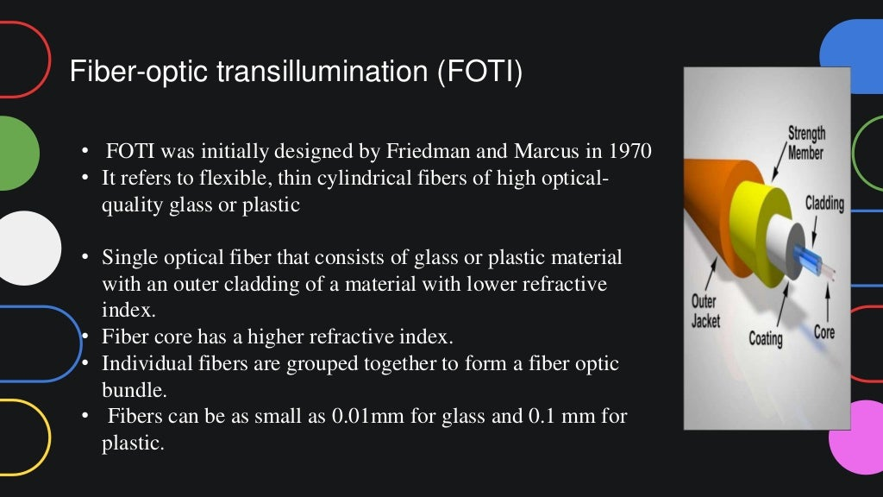

Slide 30
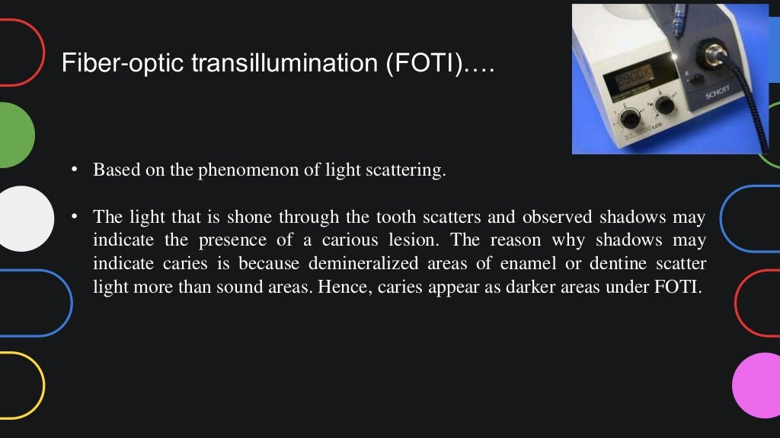

Slide 31
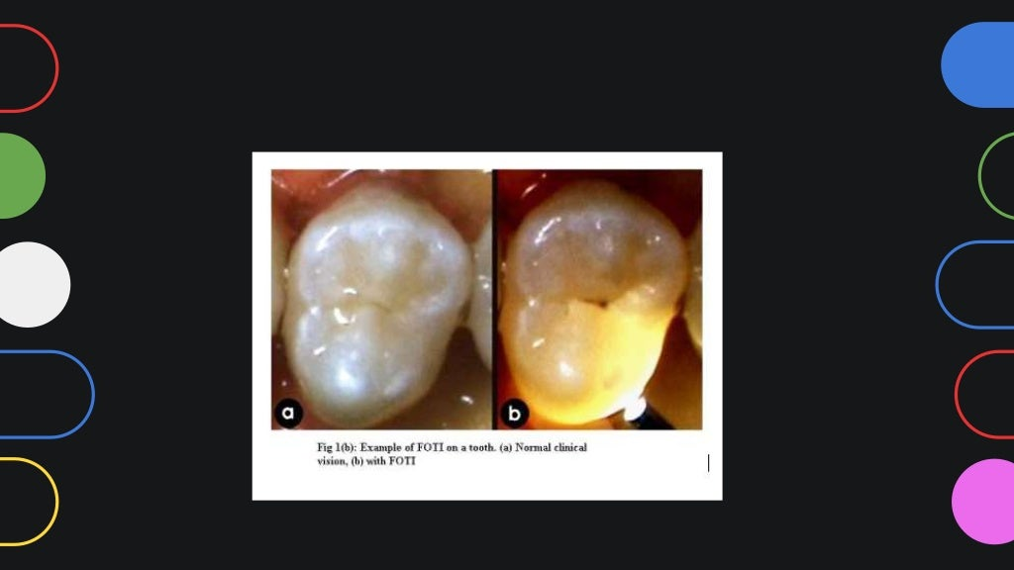

Slide 32
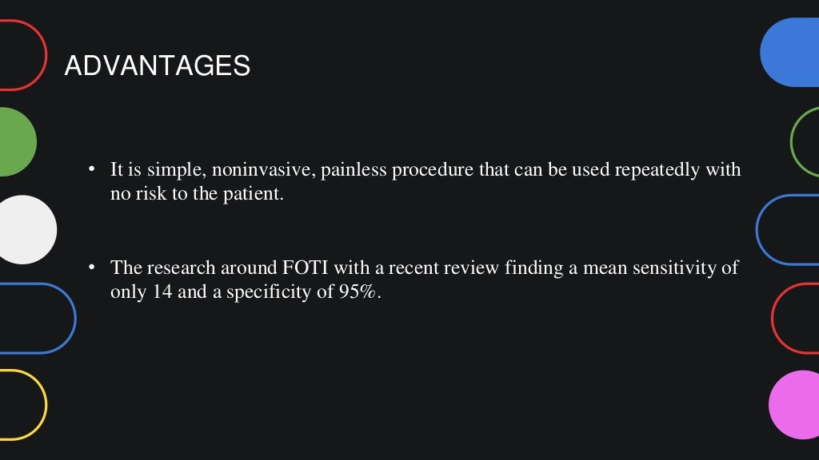

Slide 33
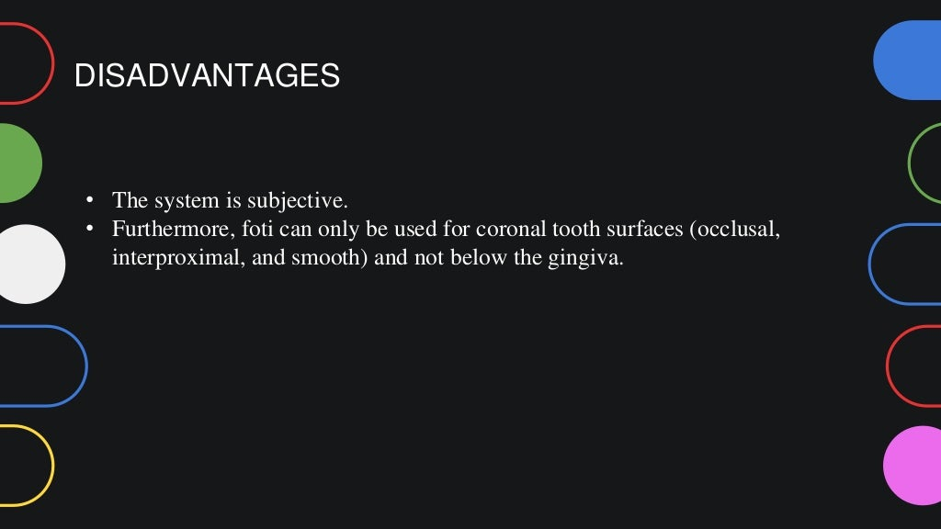

Slide 34
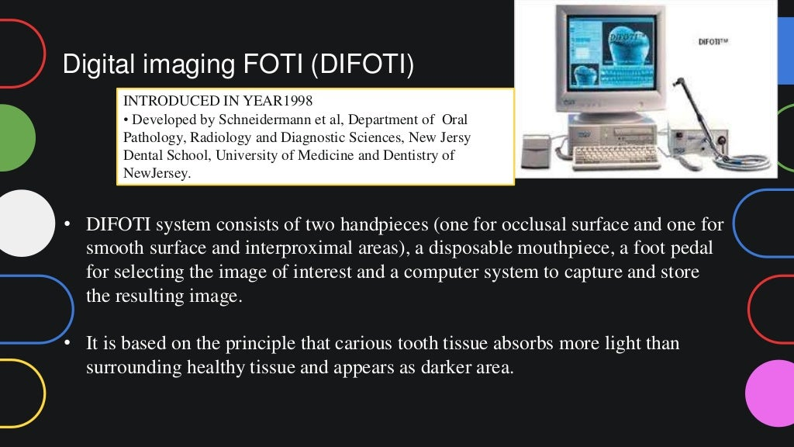

Slide 35
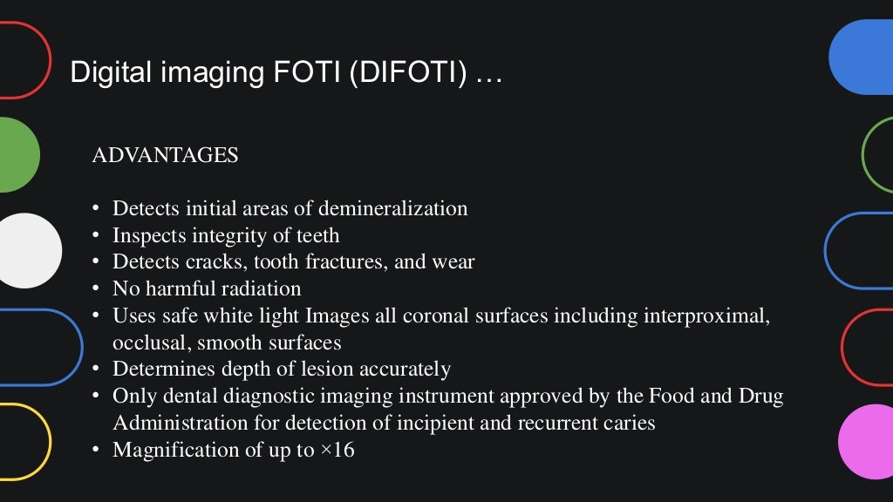

Slide 36
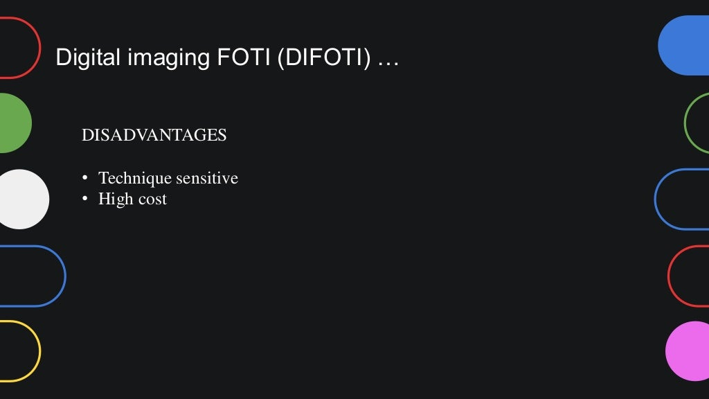

Slide 37
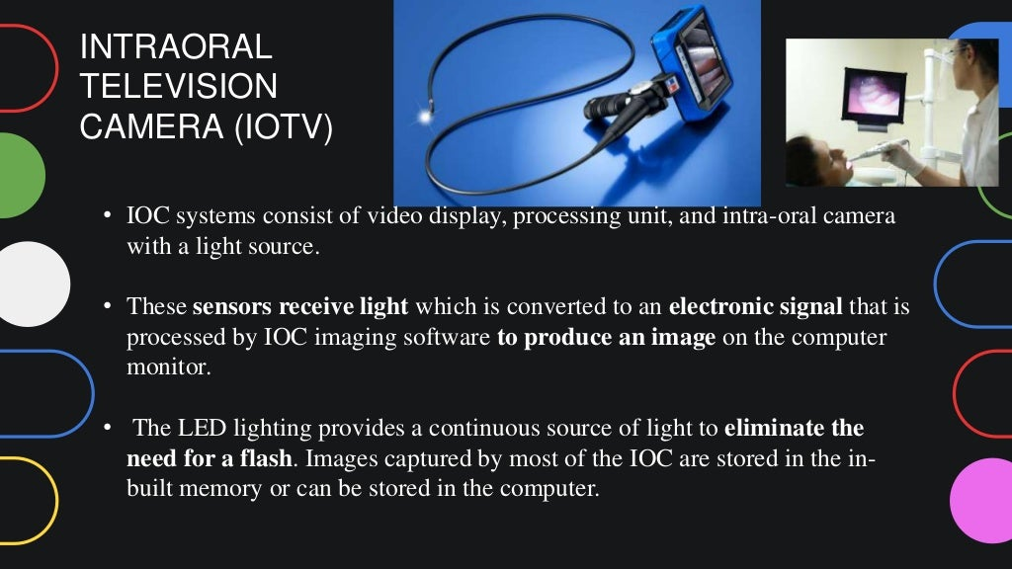

Slide 38
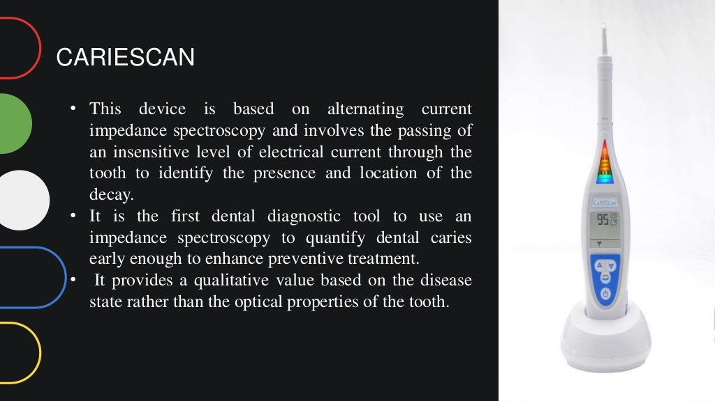

Slide 39
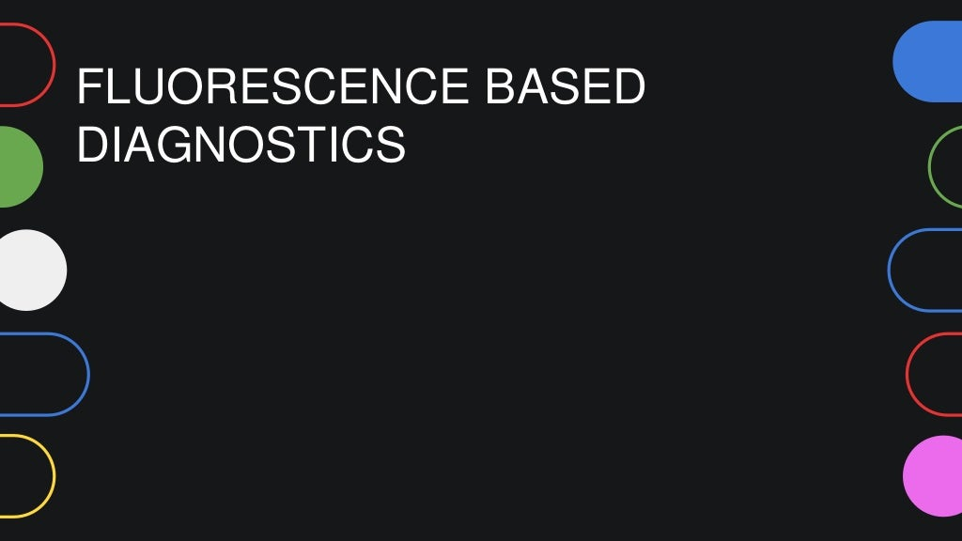

Slide 40
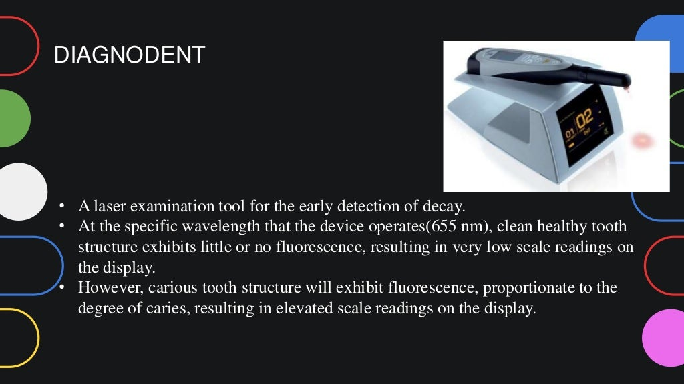

Slide 41
TAKE HOME MESSEGE
Conventional methods of caries diagnosis are
visual and tactile examination,radiographs,
UV light examination and use caries detector dyes.
The diagnodent employs fluorescence to detect
the presence of caries as it induces
changes in teeth lead to increase fluorescence
at specific excitation wavelength.
Caries meter diagnoses caries on the basis of electric impedence.

Slide 42
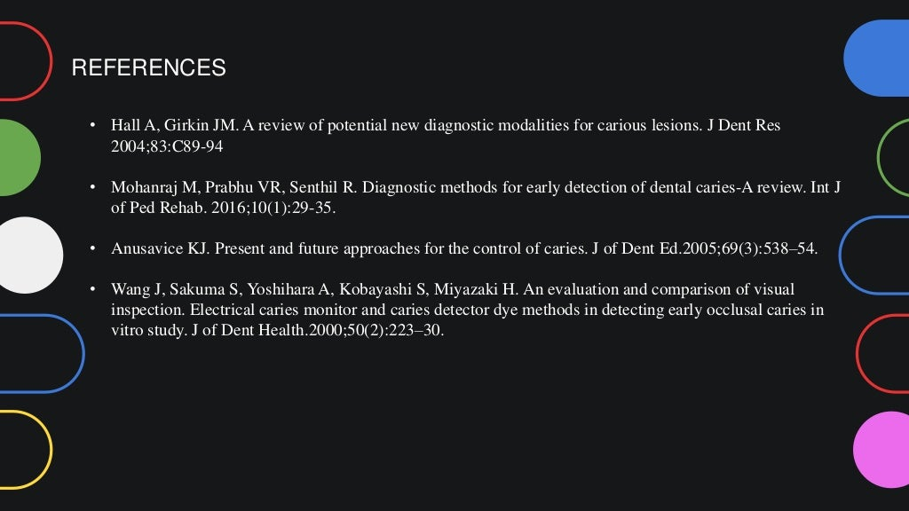

Slide 43
